Slide 1
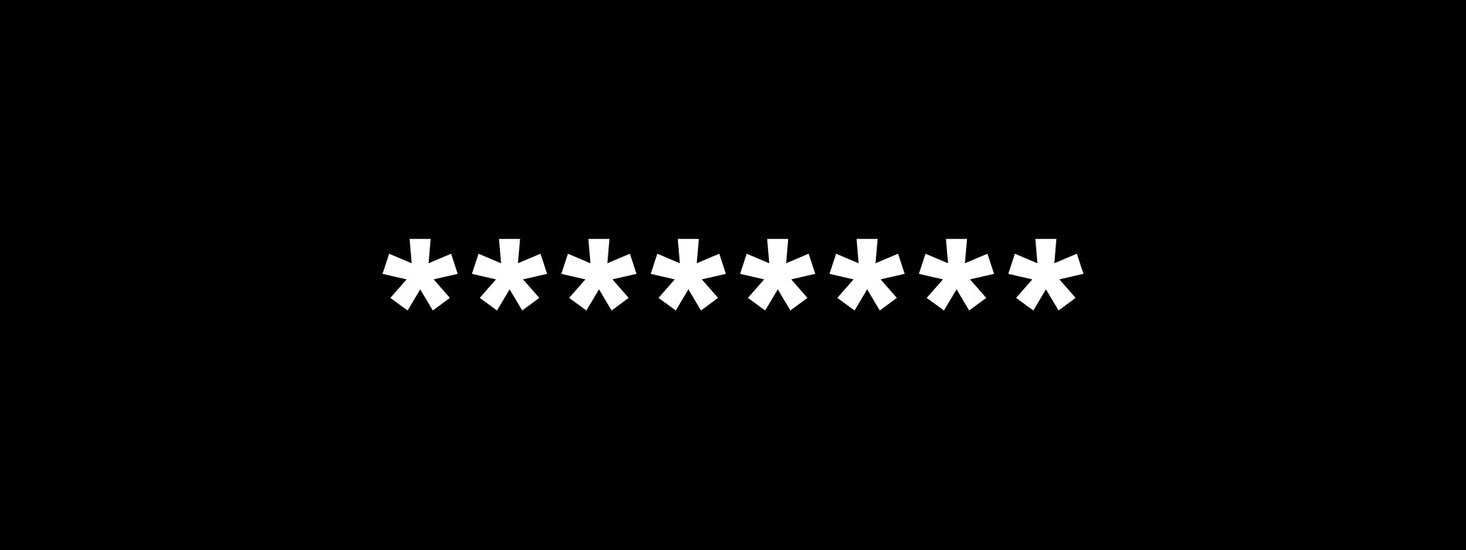
Software Development & Best Practices
ji32k7au4a83
This Photo by Unknown Author is licensed under CC BY-NC-ND
Lecture 9 – A2:2017-Broken Authentication

Slide 2
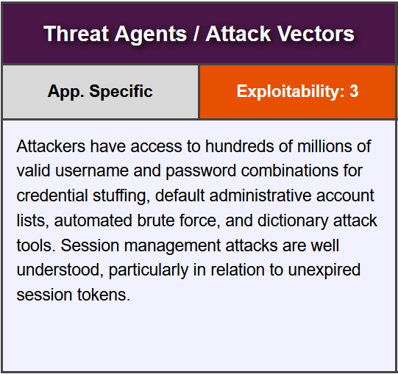
A2:2017-Broken Authentication

Slide 3
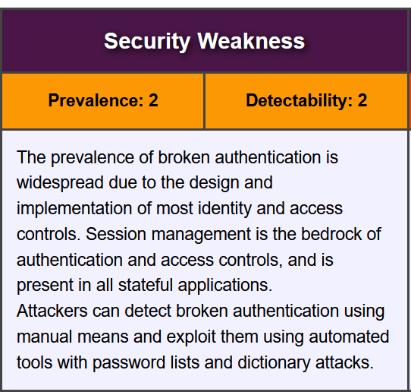
A2:2017-Broken Authentication

Slide 4
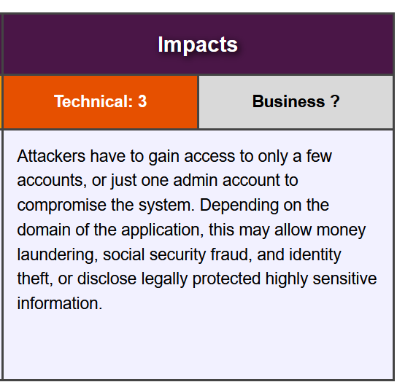
A2:2017-Broken Authentication

Slide 5
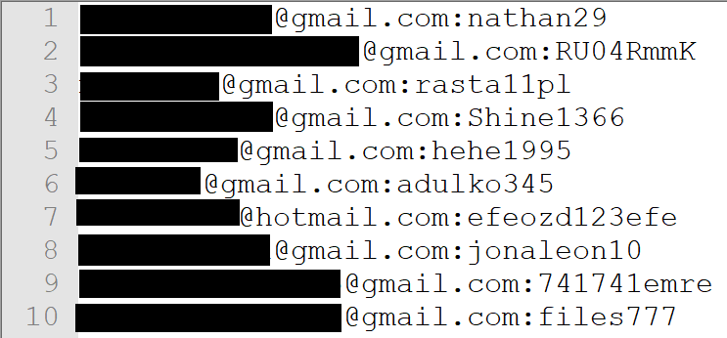
Credential Stuffing
In January 2019, a file appeared on the dark web containing 773 million unique email addresses and 22 million unique passwords.
After that there were a rash of attacks on peoples accounts due to this. Why did this happen?
Three main reasons:
Many web-based systems use email addresses to identify the user
Many people re-use passwords,
Most people use a very small number of the possible passwords.
This Photo by Unknown Author is licensed under CC BY

Slide 6

Credential Stuffing
From your other coursework you should be familiar with brute force attacks. Where an attacker tries every possible password.
These attacks, however, weren’t brute forcing people's passwords.
Instead, they were trying every account name and password from a long list. We call this: credential stuffing.
Web applications are vulnerable to this when they:
Rely entirely on usernames and passwords
Allow reusable identifiers (like email addresses)
Have short minimal password lengths.
This Photo by Unknown Author is licensed under CC BY-SA

Slide 7
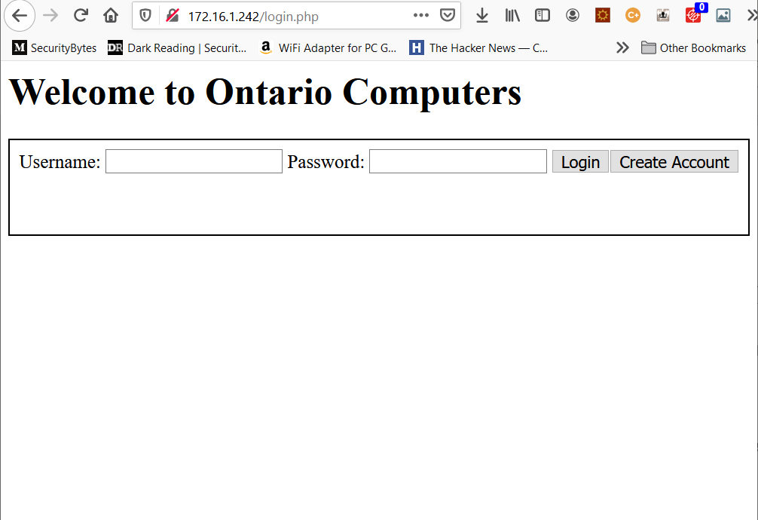
Credential Stuffing
So, let’s try and crack a system!
Download the zip file associated with this module and find the file login.php. You can upload that to your webserver in /var/www (you will also need the ontario_computers database from the last lesson)
If you point your browser at it, you should see something like the image on the right.
Here we have a simulated login page like you might find on a simple web store. You can enter a username and password and you can create an account.

Slide 8
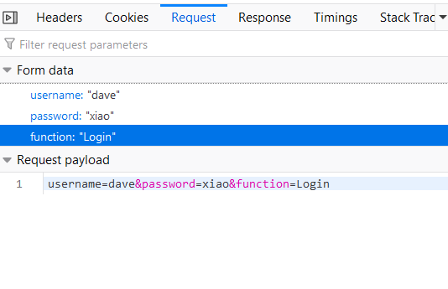
Credential Stuffing
Your first step when attempting to penetrate any system is to do reconnaissance!
Hit ctrl-shift-I and bring up the network tab (in Firefox) now try and log in using a password you know is wrong (if you managed to crack the administrator password last lesson don’t use that!).
A wrong password should cause the app to say “Authentication failed” on the screen.
On the right-hand side of the network tab. Click the “Request” tab and you should see what is in the image on the right.

Slide 9
Credential Stuffing
What we see here are three form fields being sent via POST to the URL http://<your server ip>/login.php
All we need to try credential stuffing here is to pick a username and make an enormous number of POST requests. Each with a different password.
For that we will need some sample passwords.

Slide 10
Credential Stuffing
Normally credential stuffing uses vey large files. One of the small files I use in penetration testing is over 30GB!
Attempting to log in with 30GB of passwords would take to much time. So to simulate this kind of attack, we’re going to use a file called weakpass_sample.txt you can find it on Canvas in the zip file for this lesson.
Inside this file is just a header (“password-attempt” followed by line after line of five-character passwords.
Now that we have a lost of passwords. We need a way to generate dozens of POST requests.
password-attempt 2pn9d 4409d 42n9d 2plwd 42lwd 2pn9c 2plwc 2r09c 4409c 42n9c 42lwc 2plvm 42lvm 2pn8m 2r08m

Slide 11
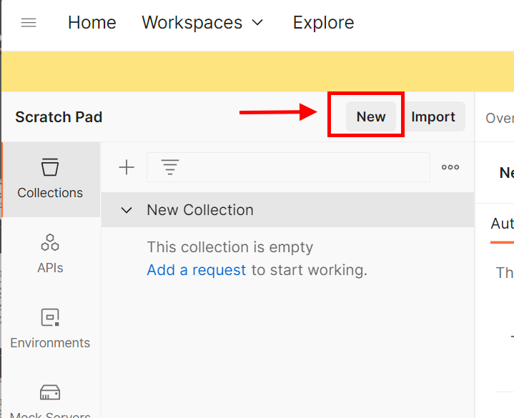
Credential Stuffing
If you recall, earlier in this course we used the tool postman to generate a POST request. We can do the same thing here.
Open up the application and select “New” from the menu at the top left!
When the menu comes up select “Collection” from the list of projects you can create.

Slide 12
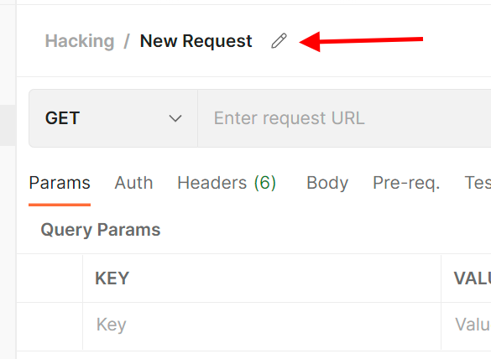
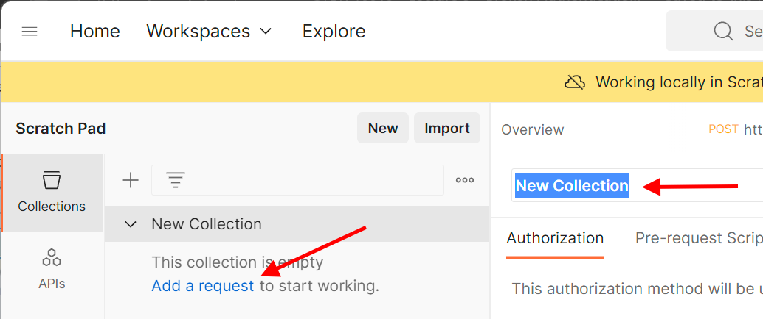
Credential Stuffing
To give your collection a name by moving your mouse to the words “New Collection” in the right-hand panel and clicking on the pencil icon when it appears. Then type in a descriptive name like “hacking”.
Next, click on the words “Add a request” in blue on the left-hand panel.
Give your new request a name by again scrolling your mouse over to the words “new request” in the right-hand panel and clicking on the pencil icon when it appears.

Slide 13
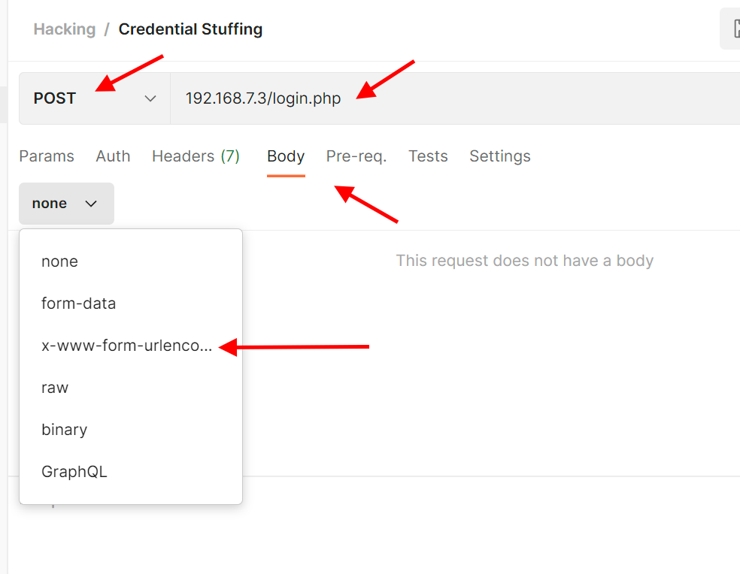
Credential Stuffing
Now use the drop down to select the POST method.
Then enter the URL of the login.php application on your TurnKey Linux system. (Your IP address may be different than mine.)
From there click on the “Body” tab and use the drop-down to select x-www-form-urlencoded.

Slide 14
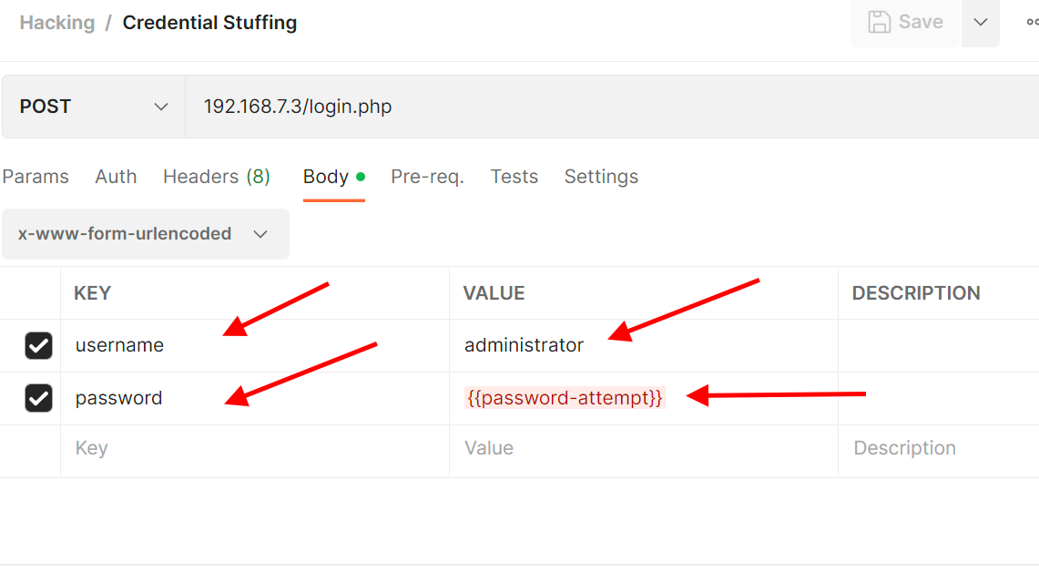
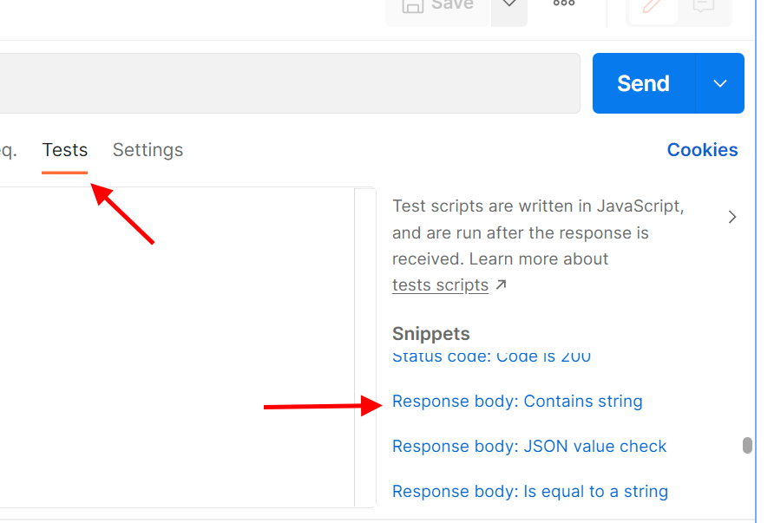
Credential Stuffing
Enter a form field with the following key/value pairs. username/administrator and password/{{password-attempt}}
Select the Tests tab, then scroll down on the right hand side until you see “Response body: Contains String”. Click on this.

Slide 15
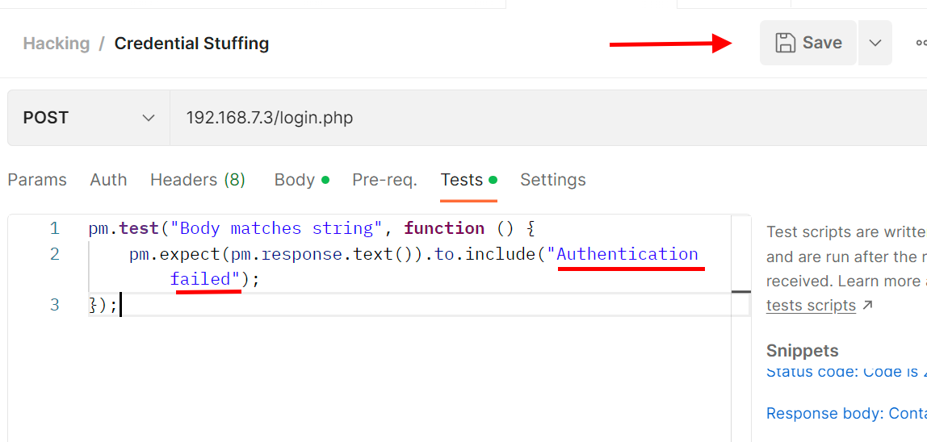
Credential Stuffing
Replace the text that has now populated the textbox from “string_you_want_to_search” to ”Authentication failed” and click “Save”.

Slide 16
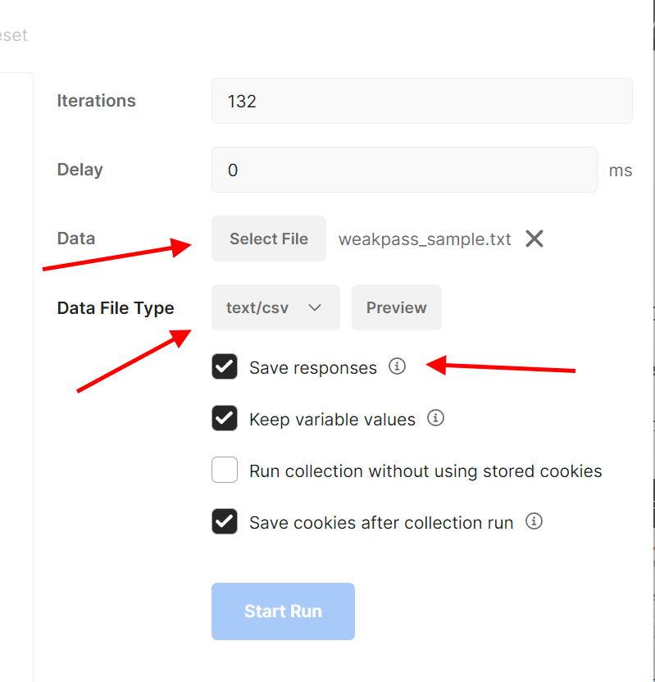
Credential Stuffing
On the far right-hand panel. Click the button marked “Select File” and choose the file weakpass_sample.txt which was part of the zip file for this lecture.
If it doesn’t show up automatically. Set the data file type to “text/csv”.
Make sure “Save Responses” is checked.

Slide 17
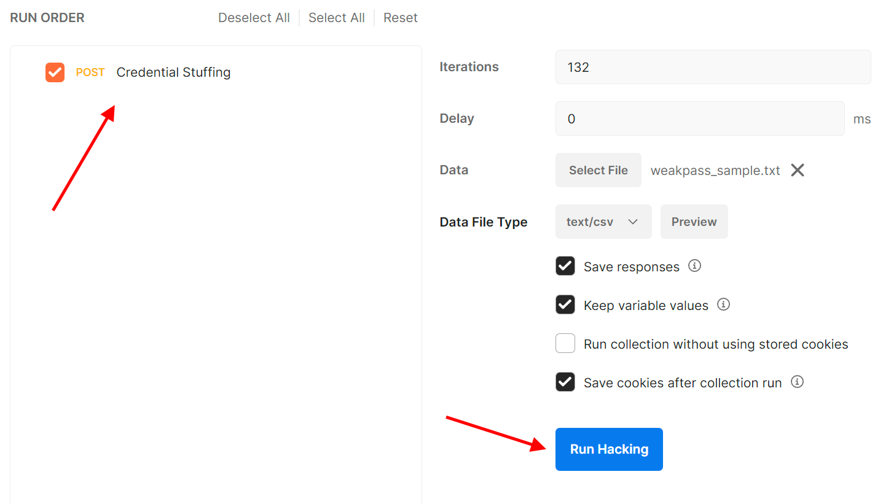
Credential Stuffing
From the far left-hand panel. Drag your request to the middle-panel.
Once you have done that the blue “Run” button should be available. Click that and watch your script attempt to do credential stuffing!

Slide 18
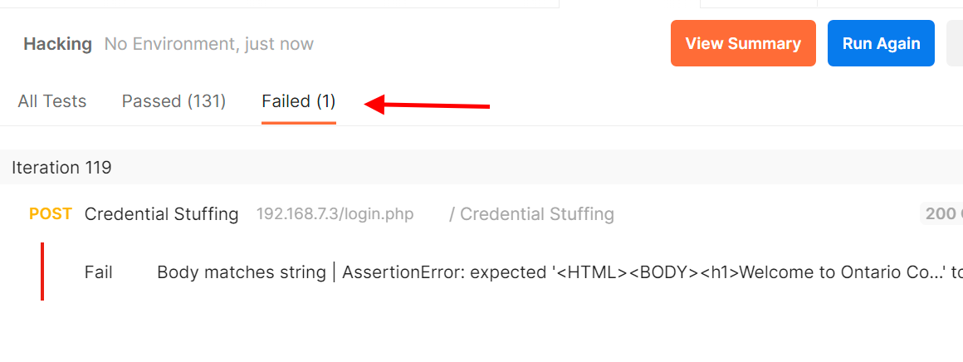
Credential Stuffing
When the run ends you should see a window like the one below. Since the test we added to our request was checking to see if we receive the message “Authentication failed”. It will pass our test whenever it tries the wrong password.
At the top of the summary window, you should see that 131 of our tests passed and one failed. This means our script saw one result that wasn’t “Authentication filed”. In other words, one of the passwords worked!
To find out which one, click on the word “Failed (1)” to view only failed requests.

Slide 19
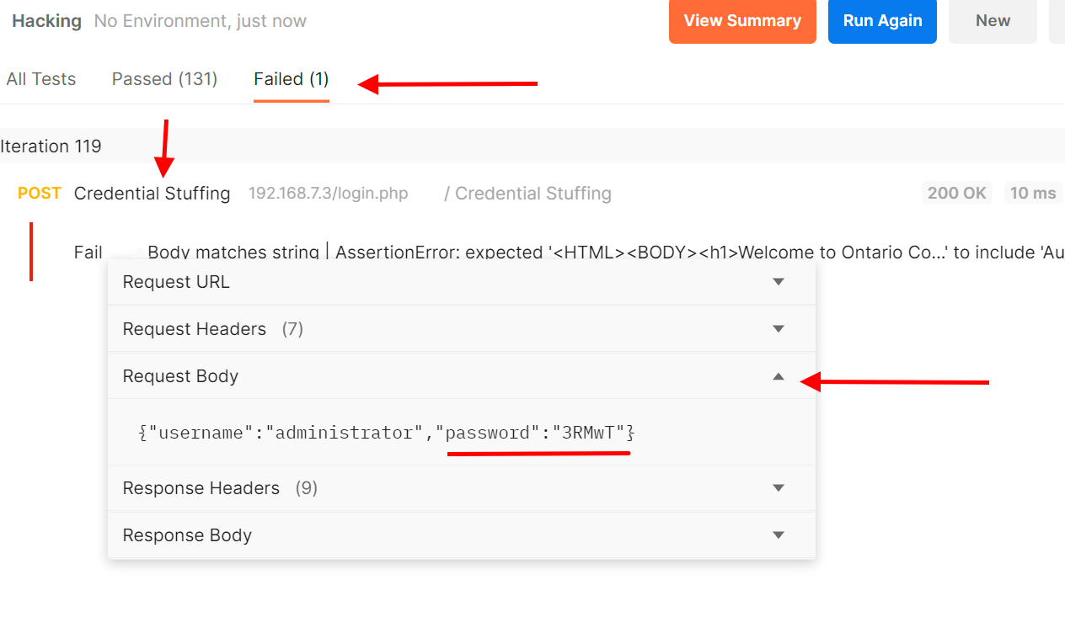
Credential Stuffing
To see the request details click on the name of your request (we named ours “Credential Stuffing”).
You should now see a drop down with the names of different parts of the HTTP Request.
Since what we are looking for is the information, we sent in the form fields. We know that appears in the HTTP Request body. So, click on that drop down to see what was sent to the login.php
You have just now HACKED the administrator’s password. Go ahead and try logging in with it!

Slide 20
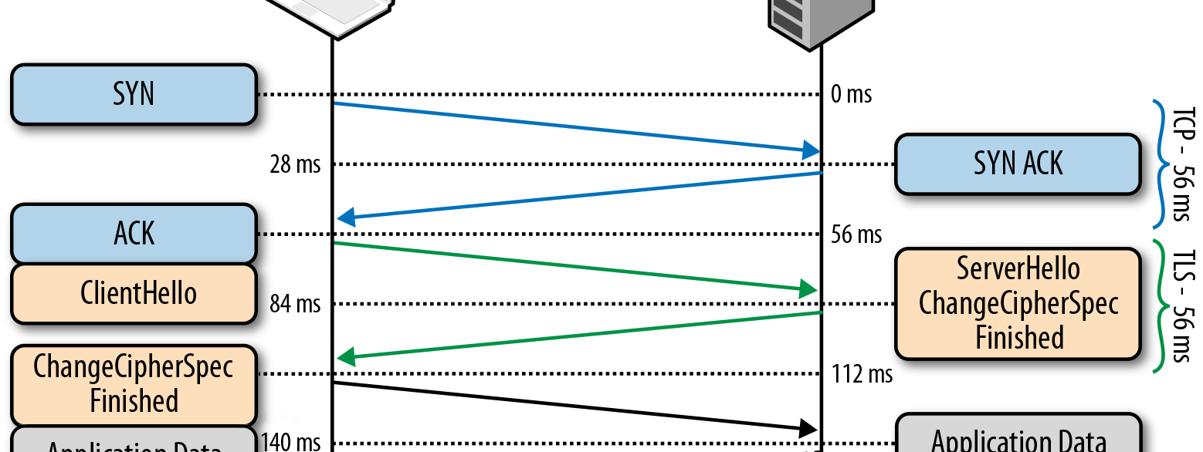
Session Key Hacking
This Photo by Unknown Author is licensed under CC BY-SA

Slide 21
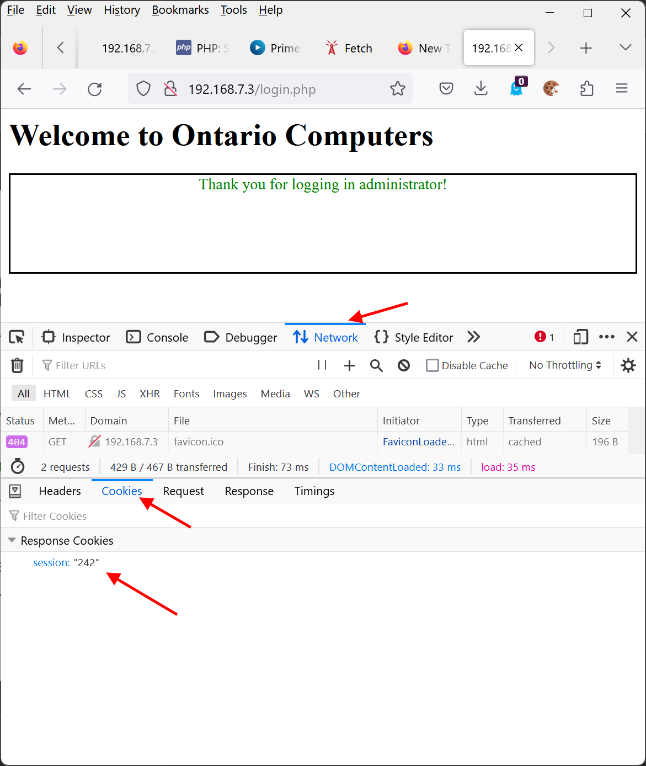
Ancient Session Keys
You may have noticed that once you log into the login.php app with the administrator credentials. We can return to the same URL and each time are greeted with the “Thank you for logging in administrator!” message.
To see what’s going on here we use Firefox developer tools.
Click on the “Network” tab and then on the “Cookies” tab and you will see that there is a single cookie being passed back and forth between you and the server. A cookie called “session”.

Slide 22
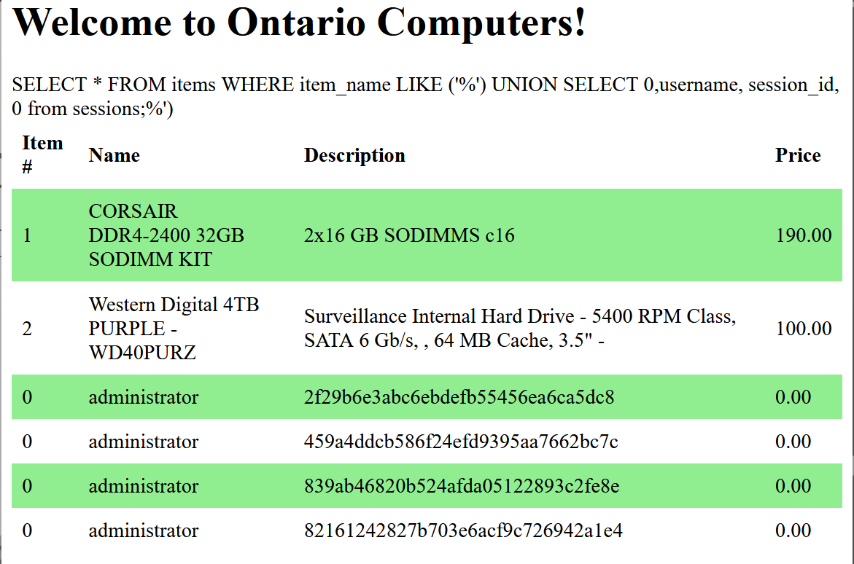
Ancient Session Keys
This should ring a bell, as in the last module, our reconnaissance revealed that there is a table called session in the ontario_computers database.
Using the same SQL Injection technique from that lesson, we can look at what is stored there.
http://<your server IP>/store_items.php?search=%27)%20UNION%20SELECT%200,username,%20session_id,%200%20from%20sessions;

Slide 23
Ancient Session Keys
By looking at he data on the right we see that there is at least one session_id associated with each account, and it appears to be hashed.
Now of course we already know what the session key is because we are currently logged in as the administrator but let's assume, we didn’t.
Another thing we learned last lesson is that while there is a field named issue_date there doesn’t seem to be anything indicating when the session expires.

Slide 24
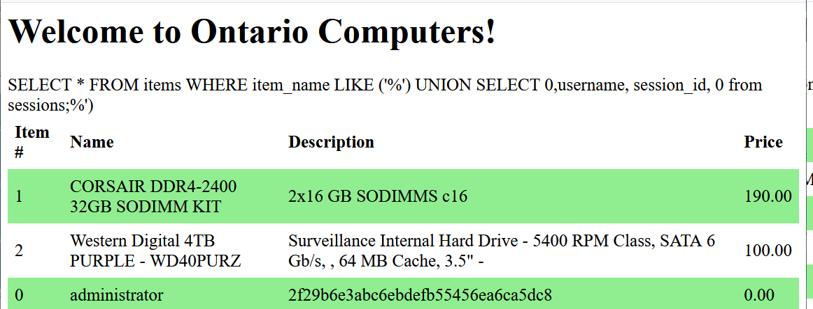
Ancient Session Keys
Many systems have sessions with very long expiry times (and a few have none at all). So, perhaps there’s an opportunity to use this information to access the system.
While the session cookie (sometimes called a “session key”) is hashed in the database it isn’t hashed until it gets to the server.
All we need to do is set our cookie equal to the unhashed value of the session key used by the account we want to compromise.

Slide 25
Ancient Session Keys
When the owners of the Ontario Computer’s site decided to hash the session key. They were being a bit clever. The idea is that even if someone compromised the database (like we just did) they wouldn’t necessarily learn the session_id of every user.
Now of course, we could attempt to crack the hash but there are a couple of reasons not to:
The first is that not all MD5 hashes are equally weak and the second is that they may not be using an MD5 hash.
Instead, there is one other way that the security could be weak…

Slide 26
Ancient Session Keys
Most websites will use something like a session key – since the alternative is your browser constantly sending your password to the website which is far less secure.
Because of this any good hacker is going to try to find out what they can about how the session keys are generated.
In order to do so, we need to force the application to generate a lot of them!
Since the app has an option to create accounts. We will just use that!
But first we need to get rid of the cookie we have (since it keeps logging us in as the administrator!).
<HTML><BODY><FORM method='POST’> <input type='text' name='username’ /> <input type='text' name='password’ /> <input type='submit' value='login’ /> </FORM></BODY></HTML> <?PHP $sent_password = $_POST['password’]; $sent_username = $_POST['username'];
echo $sent_password; ?>

Slide 27
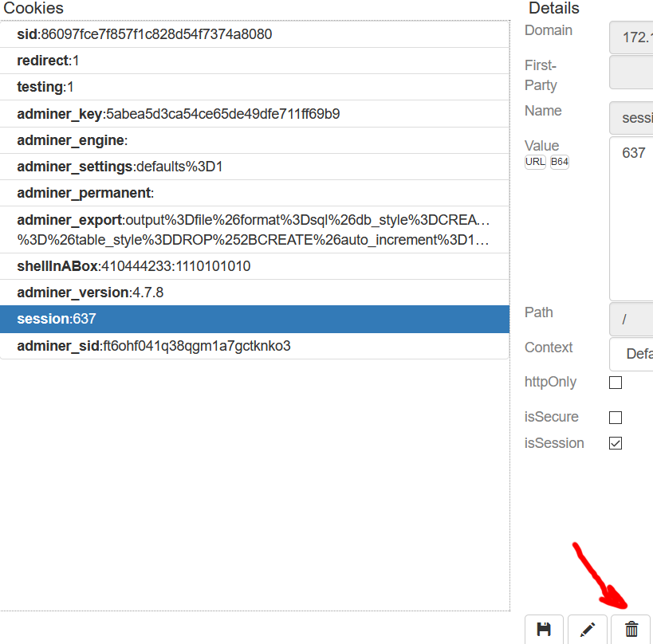
Ancient Session Keys
There are a lot of ways to manage cookies.
I use a tool called “Cookie Quick Manager” which you can add to Firefox by going here:
https://addons.mozilla.org/en-CA/firefox/addon/cookie-quick-manager/
It gives me a cookie menu in the top right. When I select it, I can enter the IP address of my server and see the cookies that were set by it.
I can then select the “session” cookie and click the delete button to get rid of it.

Slide 28
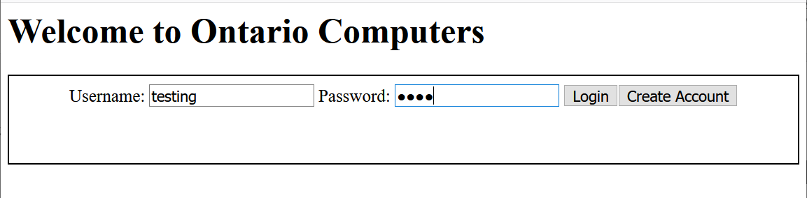
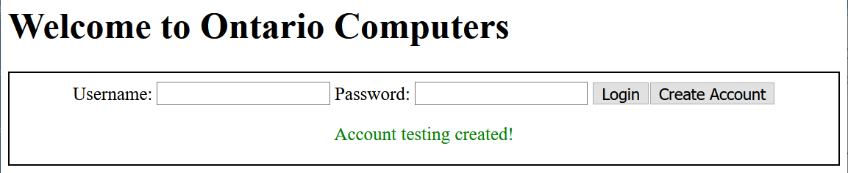
Ancient Session Keys
From here our reconnaissance can be as simple as making up several usernames and passwords and clicking “Create Account”
We should be greeted with the message “Account <account name> created!”
Each time you do, use the browser developer tools to examine your session cookie. The number I get is 83 (yours will be different).
Using your cookie manager, delete the cookie and try again. About 10 more times should do it. The numbers I got were: 83, 636, 353, 871, 303, 578, 51, 820, 79, 470, 976

Slide 29
Ancient Session Keys
Looking at these numbers we can see that the largest number I got was ‘976’. If the session keys are being assigned randomly, we would expect them to be evenly distributed over the range of possible numbers.
This tells us one of two things: Either the numbers aren’t very random, or they are being picked.
A word cryptographers use for the amount of randomness or variability in a value is “entropy”. So Ontario Computers seems to have a session key with very low entropy.
Clearly this is something exploitable with a tool like Postman. Open that application again and create a new request.
We can do this in the collection we already created.

Slide 30
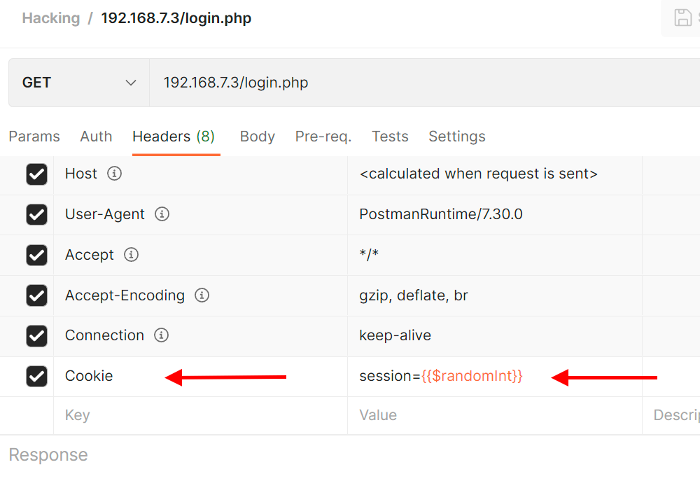
Ancient Session Keys
I called mine “random session” this only needs to be a GET request. Click on the new request name in your collection to edit it.
Set up the URL to point to login.php. Then click on the “headers” tab.
Add a header to the bottom called: “Cookie” in the value section type in session={{$randomInt}}
$randomInt a built-in function that picks numbers between 1 and 1000.
Save this request by hitting ctrl-s. If you didn’t create it in the collection you used for the last exercise. Postman will give you an opportunity to do so now.

Slide 31
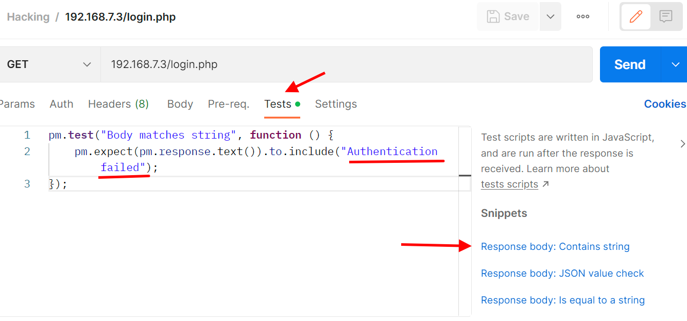
Ancient Session Keys
Now click on the “tests” tab.
Scroll down the right-hand side and select the template named “Response.body contains string”.
Alter the text “string_you_want_to_search” to “Authentication failed”
Save this with ctrl-s and then hit ctrl-shift-R to open “Runner”

Slide 32
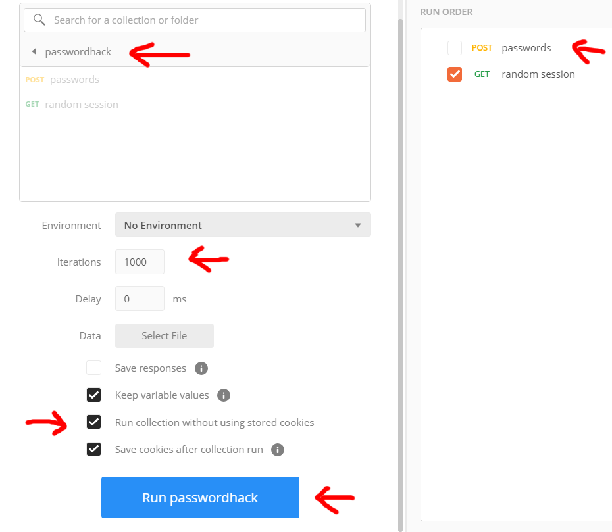
Ancient Session Keys
On the far right-hand panel set iterations to 1000
Check run collection without using stored cookies.
Drag your requests from the far-left panel to the middle panel.
Uncheck the POST request from the last exercise.
Click Run…

Slide 33
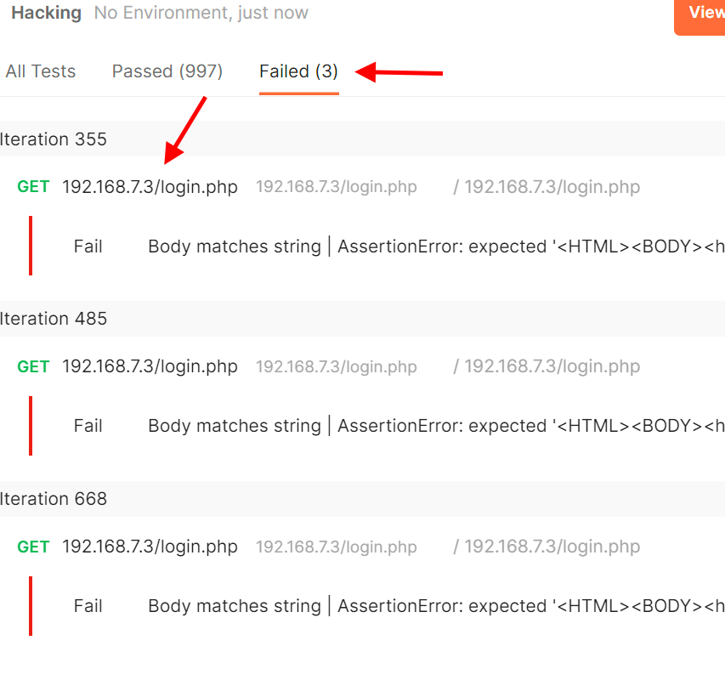
Ancient Session Keys
Depending on your machine this may take a little time to run.
After it completes, click on “failed” in the summary window to show your failures.
Choose a failed request and click on the request name and select “request headers”
Examine the cookie value that was set.
Find all the unique cookie values.
You now can forge these session cookies.

Slide 34
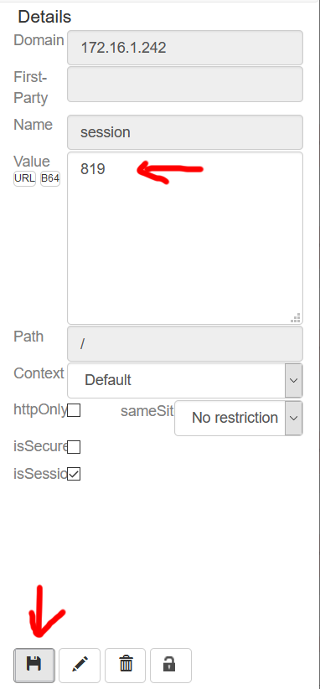
Ancient Session Keys
Using Cookie Quick Manager (or some other cookie manager) alter the value of the current session cookie for the login.php website to some of the other values.
Open your browser to http://<your server ip>/login.php
You should now be logged in as that user!

Slide 35
Media References
Read the PHP manual pages for the following. There are important details in them.
$_GET : https://www.php.net/manual/en/reserved.variables.get $_POST : https://www.php.net/manual/en/reserved.variables.post $_COOKIE : https://www.php.net/manual/en/reserved.variables.cookies setcookie: https://www.php.net/manual/en/function.setcookie isset : https://www.php.net/manual/en/function.isset print_r : https://www.php.net/manual/en/function.print-r.php

